Slide 1

Curriculum Internship Presentation
31178 – Abhishek Ulagadde
1

Slide 2

Title of Project:
Web Development Internship project in Prodigy Infotech.
2

Slide 3

Problem Statement
Task1:- Build a web page that fetches weather data from a weather API based on the user's location or a user-inputted location. Display the current weather conditions, temperature, and other relevant information.
Task 2:- Build a personal portfolio website that showcases your skills, projects, and accomplishments as a web developer. Design an attractive and visually appealing layout that captures visitors' attention. Include a home page with a captivating headline, professional photo, and summary of your skills. Provide an "About Me" section with a detailed background, education, and professional experience.
3

Slide 4

Objectives:
Showcase Professional Skills and Projects.
Responsive and User-Friendly design.
Designing good UI-UX.
To get experience related to web development.
To gain knowledge and improve skills.
To know the workings of API.
Integrate multiple web pages like Map.
Organize content for easy navigation and quick access.
4

Slide 5

Scope of the Project
1.Content Types: The website will include sections for an About page, a project showcase, and a contact form.
2. Features: Features like a photo gallery, downloadable resume, and testimonials will be integrated to provide comprehensive information about professional skills and experiences.
3. Technology Design: The site for both TASK-1 and TASK-2 will be developed using HTML, CSS, JavaScript, and Bootstrap for responsive design.
4 . Responsive Design and Accessibility: The design will be mobile-first, ensuring optimal functionality on smartphones and tablets, as well as desktops.
5

Slide 6

Technology Stack
Client :
HTML5: Provides the structure for web pages, leveraging the latest HTML standards.
CSS3: Used for styling, with advanced features like Flexbox and Grid for responsive layouts.
JavaScript (ES6+): Enhances interactivity and functionality of the websites.
Bootstrap: A frontend framework for developing responsive and mobile-first websites quickly.
Weather Data API (Ex.- OpenWeatherMap).
React Icons library.
6

Slide 7

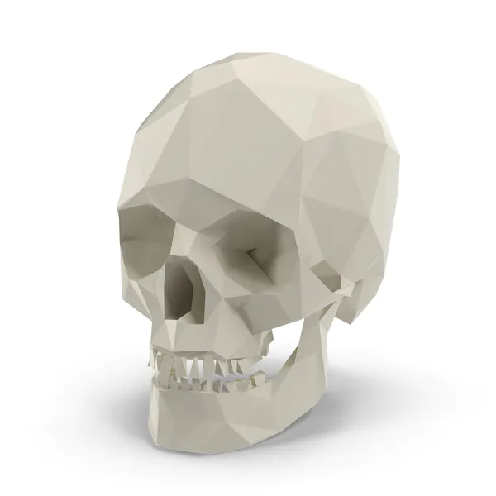


-About Technology Stack
HTML, CSS, and JavaScript are the foundational technologies of web development. HTML structures web content, CSS styles it and JavaScript adds interactivity and dynamic features. Together, they enable the creation of visually appealing, responsive, and interactive websites. This trio is essential for developing user-friendly interfaces that operate seamlessly across different devices and platforms. Each plays a distinct role but collectively, they provide the complete toolset needed for front-end development.
7

Slide 8

Weather Website (Task – 01 )
8

Slide 9
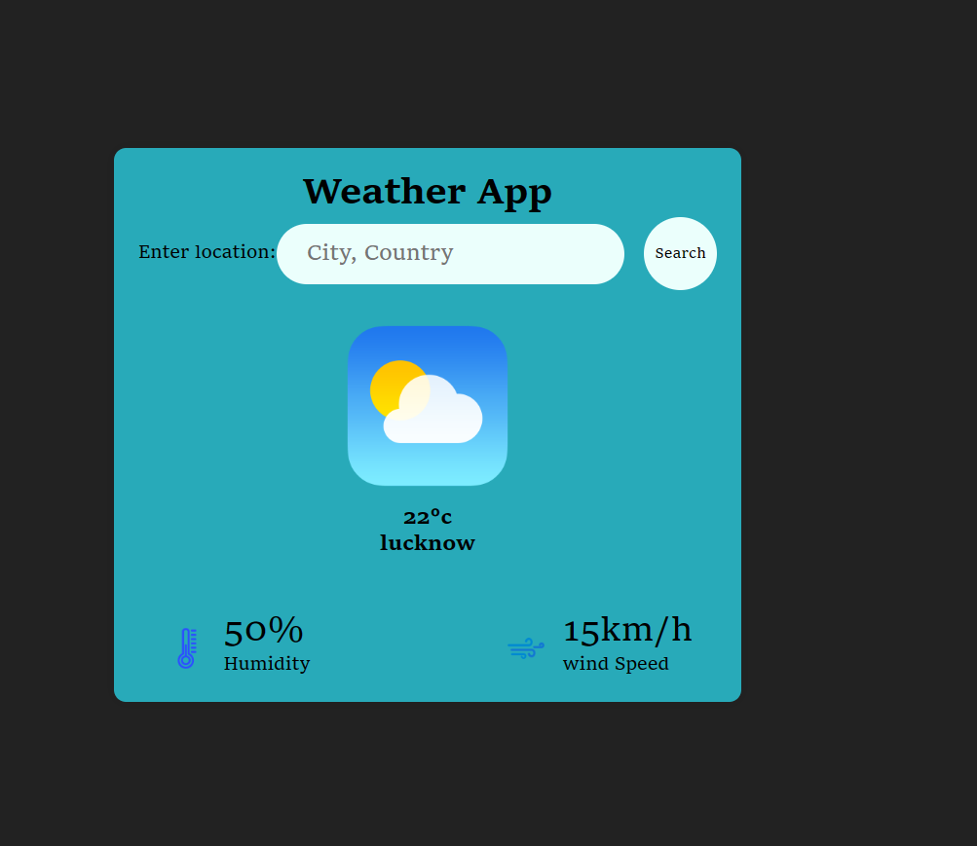
Implementation (Task – 01)
9

Slide 10
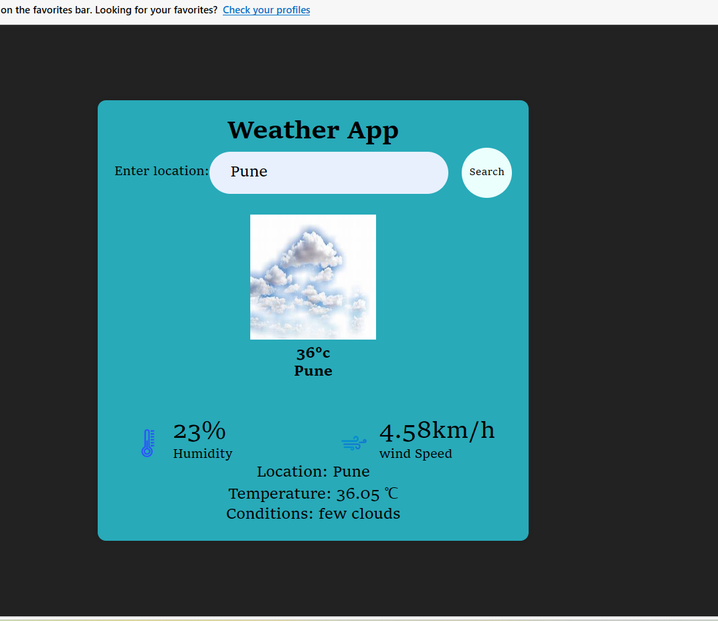
Implementation (Task – 01)
9

Slide 11
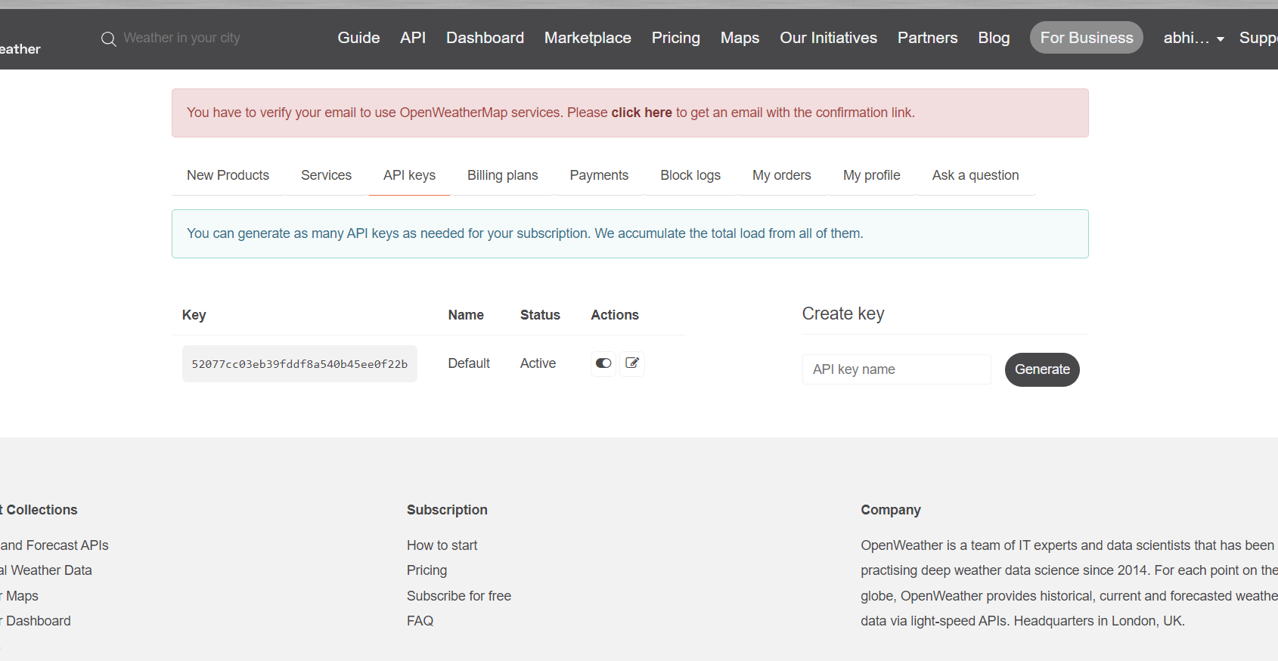
10

Slide 12

How Data get Fetched ?
11

Slide 13
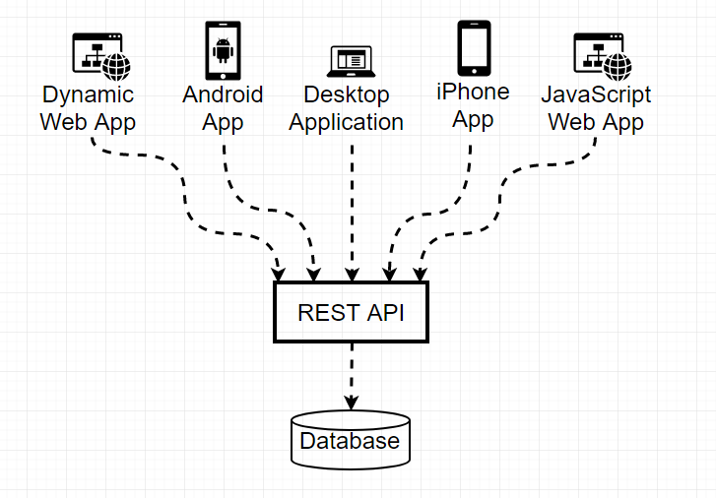
To fetch data from a weather API, a request is sent to the API's server using a specific URL, which includes the necessary API keys and parameters.
The server processes this request and retrieves relevant weather data from its databases.
The data is then returned in a structured format, typically JSON or XML, which can be easily integrated and used in various applications.
Developers must refer to the API documentation to correctly format requests and effectively handle responses.
This enables the integration of real-time weather updates and forecasts into applications, enhancing functionality and user experience.
12

Slide 14

Portfolio Website (Task – 02)
13

Slide 15
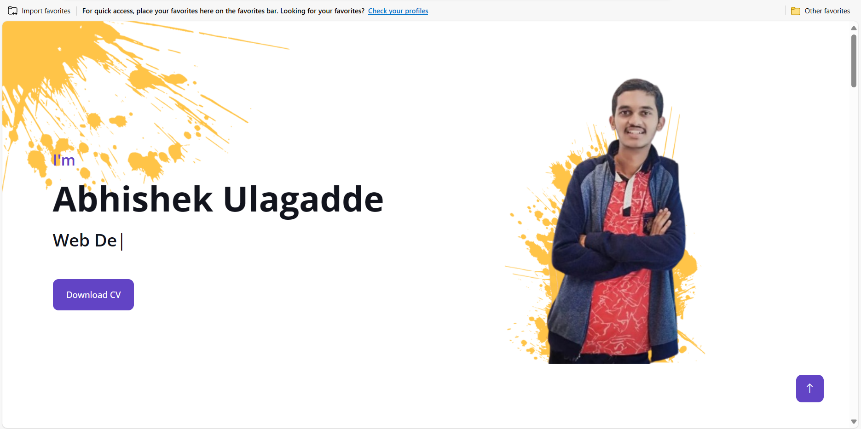
Implementation (Task – 02)
Home page
14

Slide 16
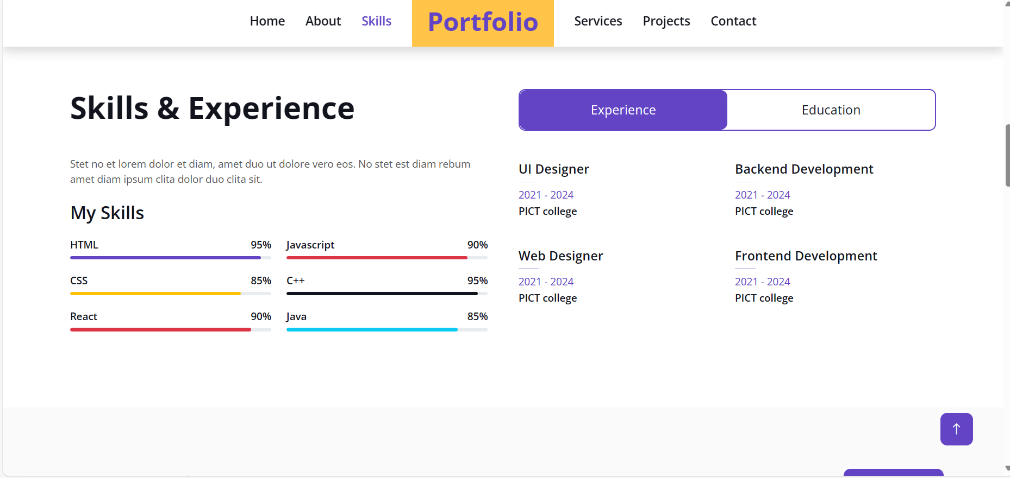
Implementation (Task – 02)
About page
15

Slide 17
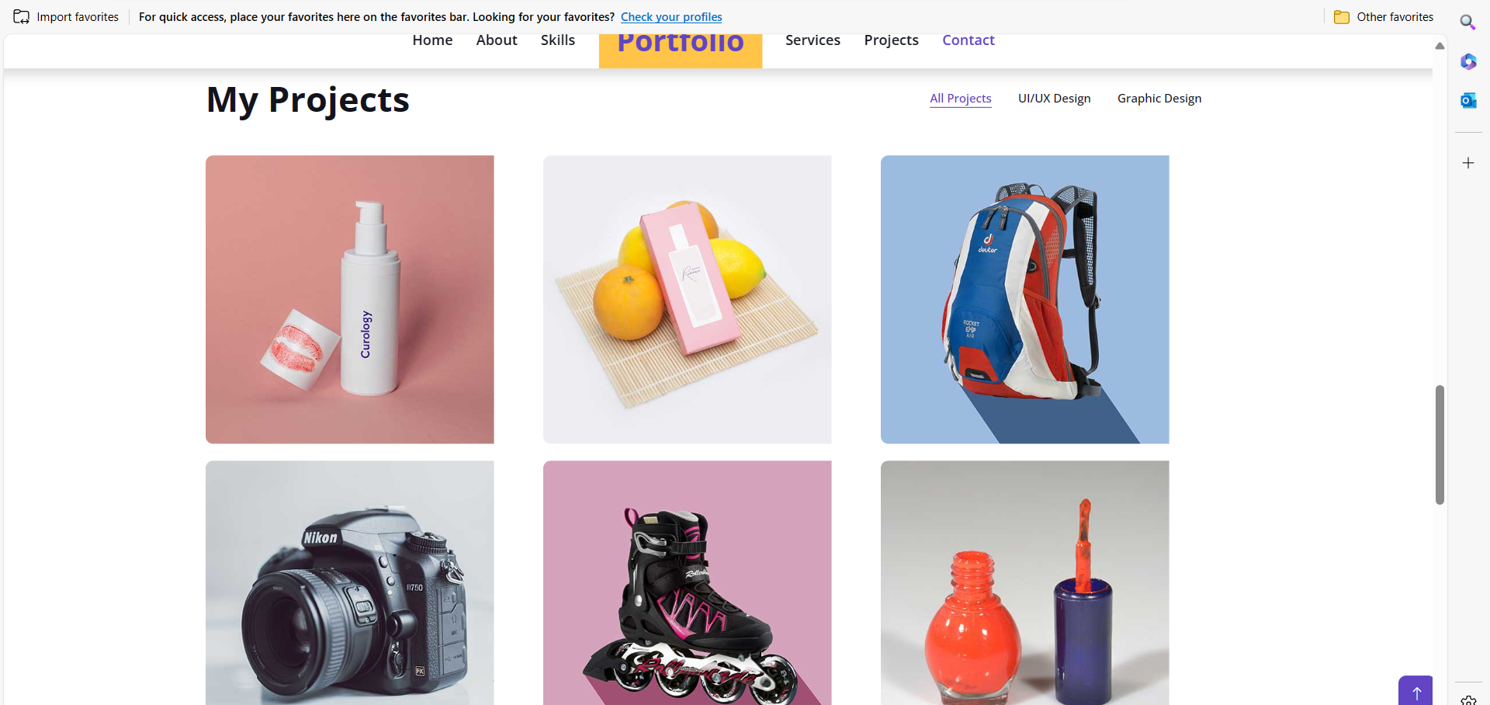
Implementation (Task – 02)
Projects page
16

Slide 18
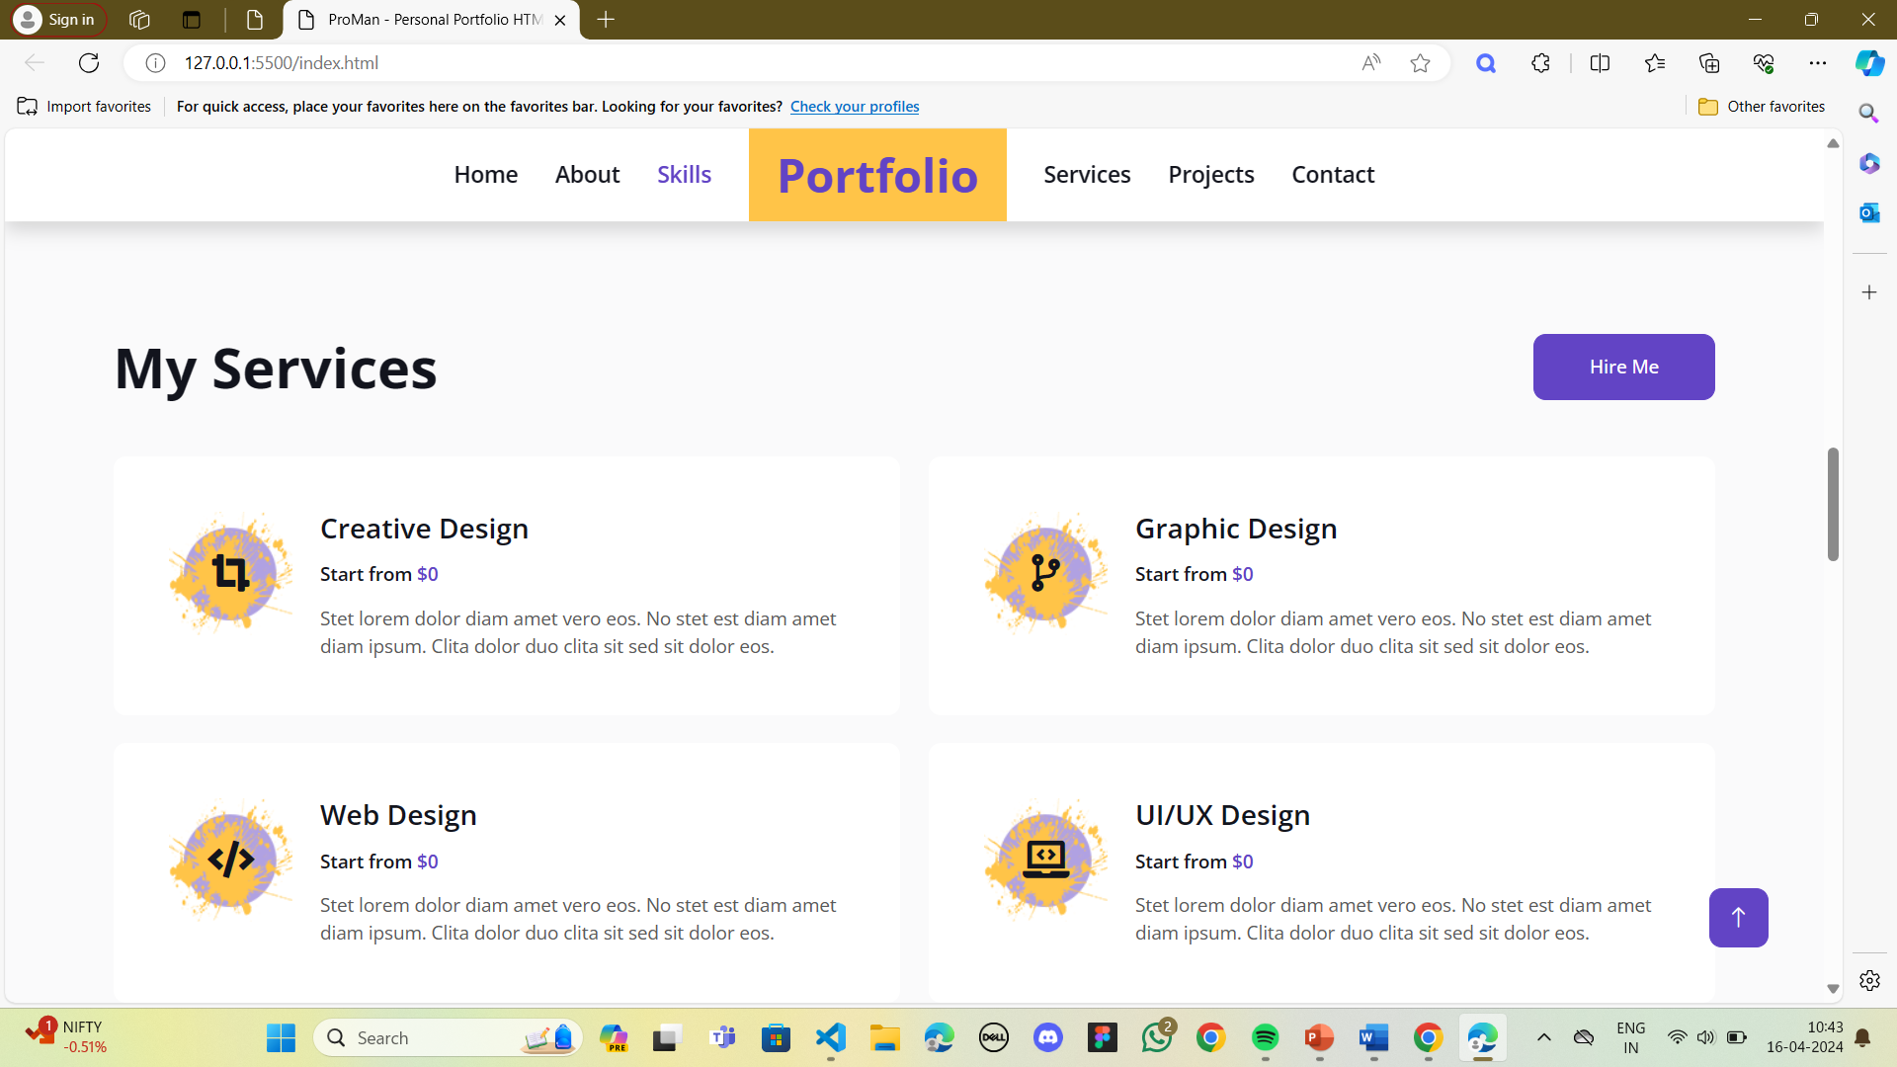
Implementation (Task – 02)
Services page
17

Slide 19
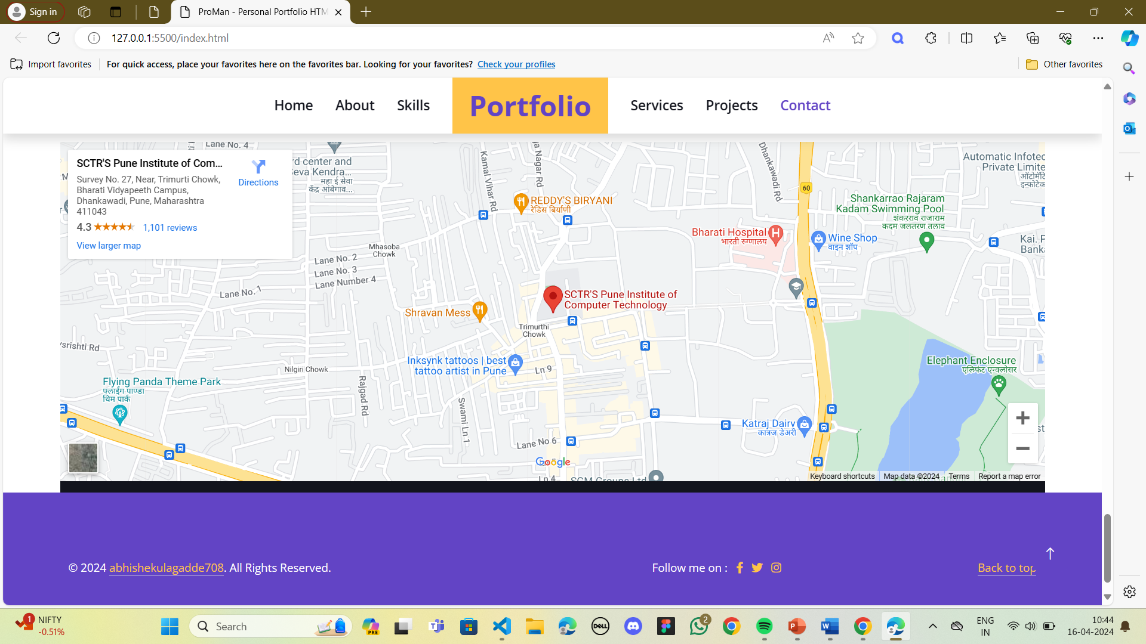
Implementation (Task – 02)
Location page
18

Slide 20
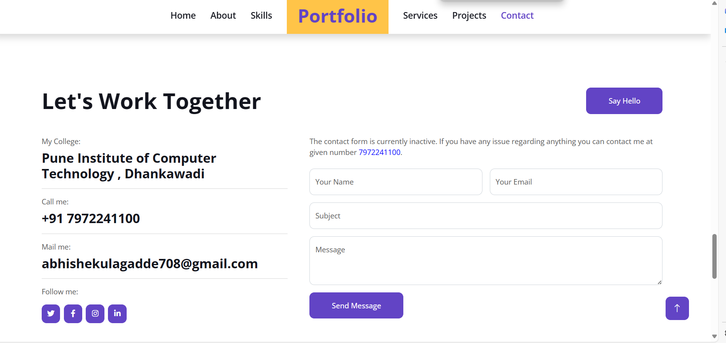
Implementation (Task – 02)
Contact page
19

Slide 21

References
• W3 Schools: Offers tutorials and references on web development languages, including HTML, CSS, and JS.
Link https://www.w3schools.com/html/html_scripts.asp
• OpenWeather API: Offers extensive documentation on using their API for accessing weather data.
Link https://openweathermap.org/
• Bootstrap Documentation: Official Bootstrap documentation for creating responsive and mobile-first websites.
Link https://getbootstrap.com/
20

Slide 22

Conclusion
Overall, the benefits of these projects extend beyond simple web presence; the portfolio website aims to significantly boost professional visibility and career opportunities, while the weather website will serve as a vital resource for daily planning and emergency preparedness.
21

Slide 23

Thank You
22

